Slide 1
CSC 131 Project X-zam
Shah Newaz
Chris Simmon
Marco Campos

Slide 2
Functional Requirements (Priority one)
Subcategories Selection
The user should be able to choose the topic that they desire to be tested on. Once the topic is chosen, questions generated for that test must only come from that specified topic.

Slide 3
Functional Requirement Continued...
Question Selection
After selecting a subcategory, the user should be able to set the number of questions to be included on the practice test.
Random Question Generator
The application will generate a random set of questions that will eventually be retrieved from the database when a read request is made.

Slide 4
Functional Requirement Continued...
Review Selection
After taking a test, the user should have the option of retaking the same test, with the option of retaking only the incorrect questions again or the whole test again.
Read Question
After generating a list of questions to select for the test, the application will obtain the selected questions from the database through the API, so that they can be displayed to the customer one at a time.

Slide 5
Non-Functional Requirement (Priority one)
Graphical User Interface (GUI)
The application will be visually pleasing, using text boxes, pictures, and buttons when applicable.
The application must be fluid and responsive.

Slide 6
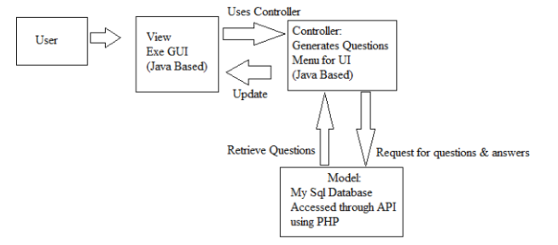
System Diagram
The system diagram represents the flow of events within the application, according to the user’s perspective. A user, when interacting with the application will first be shown the view, which contains the interface for the user to interact with. Users interact with the application using the GUI which is bound to the controller, which delegates actions between the model and the view. After the controller sends the user action to the model, the model sends the response back to the view through the controller. In this case, the model is separate from the actual application, as it is a database.

Slide 8
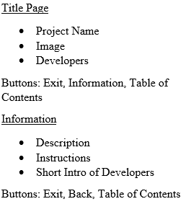
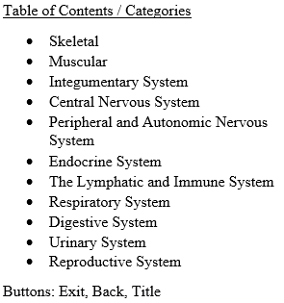
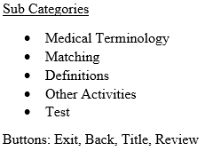
Task Set Diagram (GUI)

Slide 9
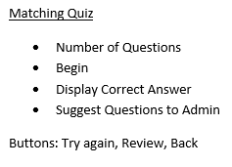
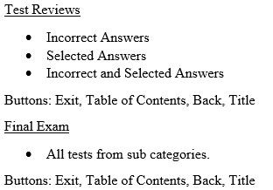
Task Set Diagram (GUI) Continue

